Slide 1
Agenda
Module 1: Introduction
Module 2: Commands
Module 3: Data And Streams
Module 4: Pipeline Introduction
Module 5: Introduction To Data Types
Module 6: Advanced Pipeline Operations
Module 7: Modules Introduction
Module 8: Advanced Data Types
Module 9: Functions, Scripts & Scope
Module 10: Flow Control

Slide 2
Module 2: Commands
Lesson 1: Commands
External commands
Cmdlets
Command discovery
Aliases
Lesson 2: Command Syntax
Reading syntax
Positional parameters
Termination character
Line continuation
Lesson 3: Help
Show-Command
Get-Command
Conceptual help
Update-help
Notes:
In this section we’re going to focus on:
basics of how to write and read PowerShell
how to find commands and help information.

Slide 3
External Commands
Use traditional CMD tools like Ping.exe, Netsh.exe, or Reg.exe in PowerShell
Runs in a separate process
Difficult to discover with no standard naming convention or syntax
CMD | PowerShell
Ping Loopback –a –n 1 | Test-Connection –count 1
Copy c:\SomeFile.txt d:\somefile.txt /Y | Copy-Item c:\SomeFile.txt d:\SomeFile -Force
Netsh interface ip show config | Get-NetIPAddress
Notes:
Focus on the fact that external commands have non-standard syntax.
In each example above , all 3 external commands use different delimiters to specify a parameter value.
PowerShell was designed to be consistent across the product and commands always use the dash to indicate parameter.

Slide 4
What is a Cmdlet?
Verb-Noun
Naming
Parameters to control Cmdlet behaviour
Native PowerShell command
Does not Launch in Separate Process
Command Name
Command Parameters
Remove-Item -Path C:\Temp -Force
Verb
Noun
Parameter Name
Parameter Value
Switch Parameter
Dashes Precede all Parameter Names
Notes:
Native PowerShell commands are called as Cmdlets(Pronounced as "Commandlets").
A Cmdlet is composed of a Verb and a Noun separated by a hyphen (-) : This gives us a nice consistent naming scheme and makes it easier to determine what things do.
Following a Cmdlet, we can provide parameters to pass data in and augment the behavior.
All parameters start with a dash (-) and most of them are followed by a value we want to pass into the cmdlet.
Some parameters are optional, and some are mandatory. This will vary by cmdlet and we show you how to find that in a little bit.
Switch parameters (like –force) are just set to on or off, like a lightswitch. They will be off by default, and on if you specify them. No value is required.
Positional Parameters:
Also, sometimes, Parameter Names are optional. The parameter's position is fixed in such cases which allows the flexibility to supply values directly to the cmdlet omitting the Parameter's name.
E.g.: Get-Service –Name spooler can also be written as Get-Service spooler . First position after cmdlet is fixed for -Name in this case.
It is better to provide names of parameters when you are new to scripting rather than use this shortcut.

Slide 5
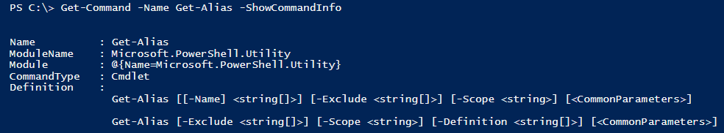
Get-Command
Discover Commands (cmdlets, functions, scripts, aliases)
Can show command syntax
Can also discover external commands (.exe, .cpl, .msc)
Notes:
Get-Command is used for command discovery.
It can discover external commands too.
By default, it shows Command Type, Command Name and Version and Source(module from which the cmdlet is added to PowerShell.
Can use wildcards to search for a command. E.g. Get-Command – Name *net* (star represents any number of characters before and after the word net) gets all commands with the word net in it.
Can search for a particular verb or a particular noun as well.
E.g. Get-Command –Verb Restart
Get-Command –Noun Service
Demo something like:
Scenario: changing the ip address
Get-command (tons of stuff)
Get-command –verb set (too much stuff)
Get-command –name *ip*
Get-command – module Microsoft.PowerShell.Management (to list all commands in a module)

Slide 6
Aliases Overview
Short Names for Cmdlets
Can be created/changed by User
Use Parameter Names as you normally would, or pass them positionally
ls
PS C:\> ls –Path C:\ -Recurse
PS C:\> Get-ChildItem –Path C:\ -Recurse
dir
PS C:\> dir –Path C:\ -Recurse
gci
PS C:\> gci –Path C:\ -Recurse
Notes:
Aliases are alternates you can use for commands that you use frequently. Aliases are typically a shorter version of a command that can be typed quickly as compared to the original command.
A user can create aliases to any command in PowerShell using New-Alias cmdlet.
E.g. New-Alias -Name list -Value Get-ChildItem.
The user created Alias only lives as long as the current PowerShell session is active.
But it is possible to export the aliases to a file and import them in a new session (refer to next slide for examples).

Slide 7
Alias Cmdlets
Name | Example
Get-Alias | PS C:\> Get-Alias -Name dir
Export-Alias | PS C:\> Export-Alias -Path C:\Aliases.txt
Import Alias | PS C:\> Import-Alias -Path C:\Aliases.txt
New-Alias | PS C:\> New-Alias -Name gs -Value Get-Service
Set-Alias | PS C:\> Set-Alias -Name write -Value Write-Host
Notes:
Examples are provided here for the cmdlets related to aliases.

Slide 8

Instructor Demonstration
DEMO
Statement Termination
Objective: Learn about Command Discovery
Demo Content: Interactive Lab
Instructions: Open the Demo code and follow along while the instructor demonstrates the concepts. Do not feel that you have to keep up with the instructor, the code merely provided for review purposes. The concepts covered in the Demo code will also be re-visited in the “Fundamental Recap” during the Lab.
To Open the Demo Run:
PS C:\> Start-WPLUSLabs -Module Module_02 -Task Demo_01

Slide 9
Cmdlet Syntax Diagram
Some parameters omitted for brevity
PS C:\> Get-Command –Name New-Alias –Syntax
New-Alias [-Name] <string> [-Value] <string> [-Description <string>] [-Option <ScopedItemOptions>] [-PassThru] [-Scope <string>] [-Force] [-WhatIf] [-Confirm] [<CommonParameters>]
[-Description <string>]: Third Parameter
Outer [] indicates this parameter is Optional
-Description: Parameter Name
Absence of [] indicate that this ParameterName is not Optional
<string>: This is the type of argument this Parameter Accepts.
Absence of [] following string indicates this argument takes ONE string, not multiple strings.
[-PassThru]: Fifth Parameter
Outer [] indicates this parameter is Optional
-PassThru: Parameter Name
Absence of [] indicate that this ParameterName is not Optional
Lack of accompanying Type indicates that this is a [Switch] parameter.
[-Value] <string>: Second Parameter
Absence of outer [] indicates this parameter is not Optional
[-Value]: Parameter Name
[] indicate that this ParameterName is Optional
<string>: This is the type of argument this Parameter Accepts.
Absence of [] following string indicates this argument takes ONE string, not multiple strings.
[-Name] <string>: First Parameter
Absence of outer [] indicates this parameter is not Optional
[-Name]: Parameter Name
[] indicate that this ParameterName is Optional
<string>: This is the type of argument this Parameter Accepts.
Absence of [] following string indicates this argument takes ONE string, not multiple strings.
New-Alias: Command Name
[-Option <ScopedItemOptions>]: Fourth Parameter
Outer [] indicates this parameter is Optional
-Option: Parameter Name
Absence of [] indicate that this ParameterName is not Optional
<ScopedItemOptions>: This is the type of argument this Parameter Accepts.

Slide 10
Cmdlet Syntax Diagram Parameter Sets
PS C:\> Get-Command –Name Stop-Process –Syntax
Stop-Process [-Id] <int[]> [-PassThru] [-Force] [-WhatIf] [-Confirm] [<CommonParameters>]
Stop-Process -Name <string[]> [-PassThru] [-Force] [-WhatIf] [-Confirm] [<CommonParameters>]
Stop-Process [-InputObject] <Process[]> [-PassThru] [-Force] [-WhatIf] [-Confirm] [<CommonParameters>]
Notice how ‘Name’, ‘InputObject’ and ‘Id’ parameters cannot be used together.
The reason being It could introduce ambiguity to the cmdlet as to which Process you intend to stop.
Notes:
Simplifying reading the syntax of a cmdlet:
If the syntax shows square brackets around the parameter name and/or parameter value, that part is optional in the syntax.
If square bracket is after a datatype like string, int etc., then it means that parameter can take multiple values (E.g. <string[]> implies an array of strings)

Slide 11
Positional vs. Named Parameters
Parameters that can be passed without using their ParameterName will have square brackets around just their ParameterName and not their Value.
PS C:\> Get-Command –Name Stop-Process –Syntax
Stop-Process [-Id] <int[]> [-PassThru] [-Force] [-WhatIf] [-Confirm] [<CommonParameters>]
Stop-Process -Name <string[]> [-PassThru] [-Force] [-WhatIf] [-Confirm] [<CommonParameters>]
Stop-Process [-InputObject] <Process[]> [-PassThru] [-Force] [-WhatIf] [-Confirm] [<CommonParameters>]
PS C:\> Stop-Procees –Id 8660
vs
PS C:\> Stop-Procees 8660
Most Cmdlets will only allow 1 or 2 positional parameters to prevent ambiguity issues.
PowerShell must be able to determine which parameter set to use.

Slide 12
Termination Characters
Statement Termination
To complete a command, use either:
Newline character (enter) , or
Semi-colon
Semi-colon can be used to execute more than one statement on a single line
Mostly there to support people coming from other programming languages
Avoid doing this often, as it makes code harder to read and manage
;

Slide 13
Line Continuation
Statement Termination
PS C:\> Write-Host “C:\
>>
>>
>>
>> # What Happened?!
>> ”
>>
C:\
When a line of PowerShell is entered that is not syntactically complete, PowerShell loops a >> prompt asking the user for the characters necessary to complete the statement. This is called Line Continuation.
What are some things that cause this?
( ), [ ], “ “, ‘ ‘ -> Incomplete Matching Pairs
Empty Pipes |
What can you do next? Complete the Statement or press <Ctrl+C>
During Line Continuation you remain in the prompt cycle until the statement is complete and you press <Enter> twice (without PSReadline).
You can manually trigger a continued line with the backtick (grave accent)

Slide 14
Instructor Demonstration
DEMO
Statement Termination
Objective: Learn about Cmdlet Syntax
Demo Content: Interactive Demo
Instructions: Open the Demo code and follow along while the instructor demonstrates the concepts. Do not feel that you have to keep up with the instructor, the code merely provided for review purposes. The concepts covered in the Demo code will also be re-visited in the “Fundamental Recap” during the Lab.
To Open the Demo Run:
PS C:\> Start-WPLUSLabs -Module Module_02 -Task Demo_02
Notes:
Demo Help etc.
Show about topics: about_alias vs. about_alias on technet

Slide 15
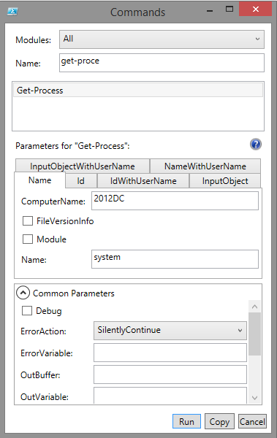
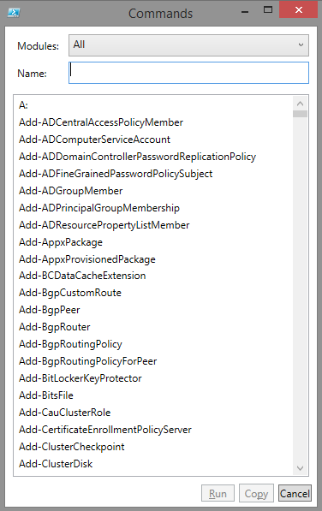
Show-Command
Show-Command cmdlet launches GUI
Populate Parameters and Insert or Execute
Fill in Parameters
PS C:\> Show-Command
Execute Command Directly
Start Typing Command Name and/or click on command in list
Insert Command with Parameters Populated
PS C:\> Get-Process -ComputerName 2012DC -Name system -ErrorAction SilentlyContinue
Notes:
PowerShell 3.0 and later add a new graphical cmdlet that can be used to learn about cmdlets and help to build them with the right parameters. It does not replace Get-Help or Get-Command. The purpose is to make documentation easier. Play with this cmdlet. You can try : show-command get-process show-command * # This will fail. Look for a solution. get-help show-command -full

Slide 16
Get-Help
PS C:\> Get-Help Get-ChildItem #or PS C:\> Get-ChildItem -? NAME Get-ChildItem SYNOPSIS Gets the files and folders in a file system drive. SYNTAX Get-ChildItem [[-Path] <String[]>] [[-Filter] <String>]... ... DESCRIPTION The Get-ChildItem cmdlet gets the items in one or more... ... RELATED LINKS Online version: http://technet.microsoft.com/library/h... ... REMARKS To see the examples, type: "get-help Get-ChildItem ... ...
Notes:
PowerShell 3.0 and later add a new graphical cmdlet that can be used to learn about cmdlets and help to build them with the right parameters. It does not replace Get-Help or Get-Command. The purpose is to make documentation easier. Play with this cmdlet. You can try : show-command get-process show-command * # This will fail. Look for a solution. get-help show-command -full

Slide 17
Get-Help Useful Parameters
Parameter | What you Get | Example
<None Specified> | Command Name, Synopsis, Syntax, Description, Related Links, Remarks | PS C:\> Get-Help Get-ChildItem
-Examples | Name, Synopsis, Examples | PS C:\> Get-Help Get-ChildItem –Examples
-Detailed | Name, Synopsis, Parameters, Examples | PS C:\> Get-Help Get-ChildItem –Detailed
-Full | Name, Synopsis, Syntax, Description, Parameters, Inputs, Outputs, Notes, Remarks, Examples, Related Links | PS C:\> Get-Help Get-ChildItem –Full
-Parameter <Names> | Parameters Specified Only | PS C:\> Get-Help Get-ChildItem –Parameter Filter
-Path <Path> | Cmdlet help relative to a Path | PS C:\> Get-Help Get-ChildItem –Path C:\
-Online | Displays online help in Internet Browser. | PS C:\> Get-Help Get-ChildItem –Online
-ShowWindow | Shows help in an external Window in –Full mode. | PS C:\> Get-Help Get-ChildItem –ShowWindow

Slide 18
Updatable Help
Help topics must be downloaded before they can be used locally
Update-Help (pulls from direct Internet access or offline copies)
Save-Help (allows help to be re-distributed)
Help contents not shipped with v3.0+
Update-Help
Automatically downloads Help content for all available cmdlets
Only downloads updated help topics
For system modules, administrative elevation required
Run PS window as admin, then run update-help
Only updates Help once per day even if run multiple times
-Force can be used to update each time

Slide 19





Update-Help Diagram
Update-Help
Save-Help –DestinationPath \\Share
Internal
Folder
Location
Internet
Update-Help -SourcePath
Internal machines do not need Internet access
Update-Help -SourcePath
Update-Help -SourcePath
Optional Default source path location GPO Setting
Notes:
GPO Setting:
Computer > Policies > Administrative Templates > Windows Components > Windows PowerShell
Enable "Set the default source path for Update-Help."

Slide 20
Instructor Demonstration
DEMO
Statement Termination
Objective: Learn about Help
Demo Content: Interactive Demo
Instructions: Open the Demo code and follow along while the instructor demonstrates the concepts. Do not feel that you have to keep up with the instructor, the code merely provided for review purposes. The concepts covered in the Demo code will also be re-visited in the “Fundamental Recap” during the Lab.
To Open the Demo Run:
PS C:\> Start-WPLUSLabs -Module Module_02 -Task Demo_03
Notes:
Demo Help etc.
Show about topics: about_alias vs. about_alias on technet

Slide 21
Module 2: Commands
Lab Content: Interactive Demos/Labs
Instructions: Open the Lab code and perform the operations at your own pace. Afterwards you may review the Demos again until the next block of instruction begins.
To Open the Lab Run:
Lab
PS C:\> Start-WPLUSLabs -Module Module_02 -Task Lab_01
Notes:
Instructor notes: Stress that these early labs are really for getting comfortable writing and reading simple commands.
Fundamental Recap (From Demo Content):
Lab:
Run simple Cmdlets with/without parameters, show that not all cmdlets can be run with no parameters using –Syntax
Run cmdlet positional vs named
Get-Command –Syntax
Get-Command WildCards
Get-Help with various parameter options
Alias manipulation
Adv
Find all commands that take a computername parameter
How many different ways can you call Get-eventlog (ParameterSets)

